Slide 2
Pilot Study of a Gamified, Social Networking App Shows Improvements in PrEP Adherence among YMSM in the US
Lisa Hightow-Weidman, MD, MPH; Kelly Knudtson, MPH; Andrew Mcgee; Mackenzie Cottrell, PharmD; Elizabeth Adam, MPH; Mary Paul, MD; Kim Desir; Donna Futterman, MD: Zak Woytowich; Kate Muessig, PhD; Kristina Claude, MPH; Sara LeGrand, PhdD.
@BATLabUNC
Share your thoughts on this presentation with #IAS2019

Slide 3
PrEP Adherence Among Youth in US
Youth struggle with adherence and don’t sustain protective levels of PrEP over time
In ATN 113, most common reasons for missing pills were simply forgot, away from home, or too busy with other things (Hosek, 2018)
May need higher levels of engagement to sustain adherence
95% of teens own a smart phone or have access to one and 96% of young adults, 18-29, own a smartphone (Pew, 2018)
App based interventions present a unique opportunity to create accessible, affordable interventions that integrate into the daily lives and habits of young people
Tenofovir diphosphate levels (fmol/punch) and PrEP dosing estimates as measured by dried blood spot assay
by Hosek, 2017. Retrieved from https://www.ncbi.nlm.nih.gov/pmc/articles/PMC5140725/

Slide 4
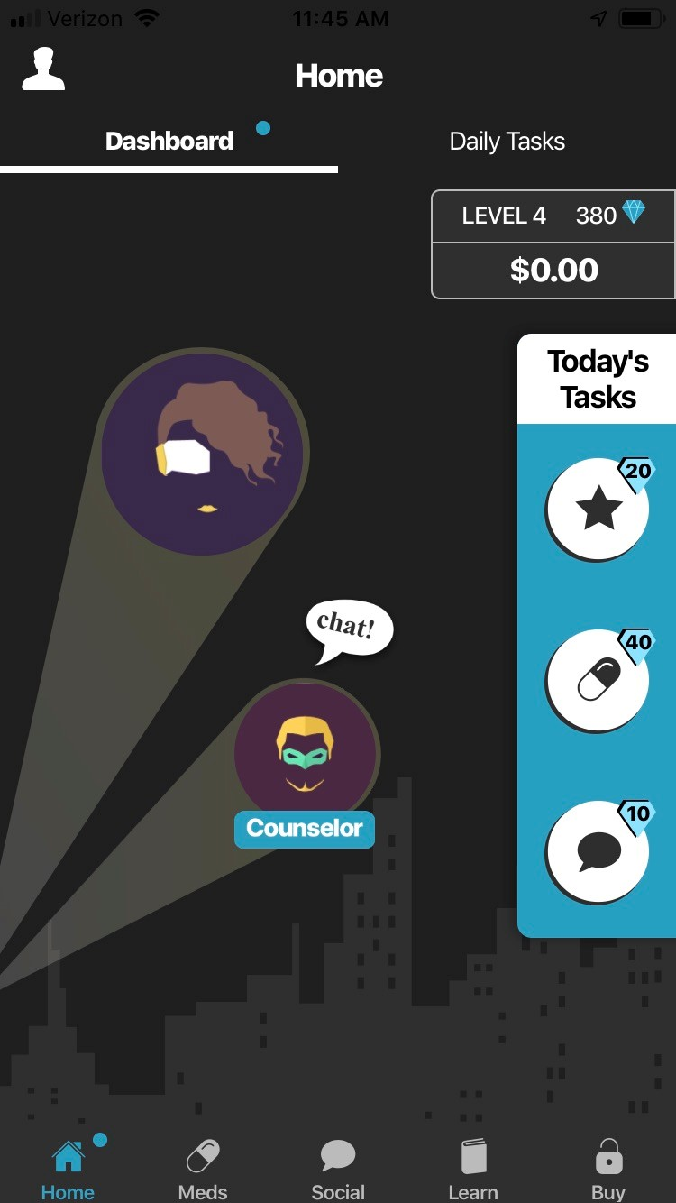
Prepared, Protected, emPowered
Earn real money and in-app points for use
P3 is a theory-based (Social Cognitive Theory and Fogg behavioral model) comprehensive social networking PrEP adherence app for iOS and Android
Designed for young men who have sex with men (YMSM) and transgender women who have sex with men (YTW) who are on PrEP
Includes interactive components encouraging peer-to-peer sharing on a social wall and the development of medication self-monitoring behaviors through completion of daily quests and personalized medication tracking.
Game-based elements, including virtual and real-world rewards, based on behavioral economics principals, encourage engagement
Strengths-based adherence counseling delivered by a centrally-located adherence counselor via in-app messaging addresses individuals’ unique barriers to PrEP adherence.
Daily Quest
Medication tracker
Social Wall
Adherence Counselor
Use points to access an exclusive web series and choose-your-own-adventure style games
Short, easy to read, articles and quiz games on PrEP, sexual health, substance use, and healthy living

Slide 5
Prepared, Protected, emPowered
P3 is a theory-based (Social Cognitive Theory and Fogg behavioral model) comprehensive social networking PrEP adherence app for iOS and Android
Designed for young men who have sex with men (YMSM) and transwomen who have sex with men (YTW) who are on PrEP
Includes interactive components encouraging peer-to-peer sharing on a social wall and the development of medication self-monitoring behaviors through completion of daily quests and personalized medication tracking.
Game-based elements, including virtual and real-world rewards, based on behavioral economics principals, encourage engagement
Strengths-based adherence counseling delivered by a centrally-located adherence counselor via in-app messaging addresses individuals’ unique barriers to PrEP adherence.
Social Wall

Slide 6
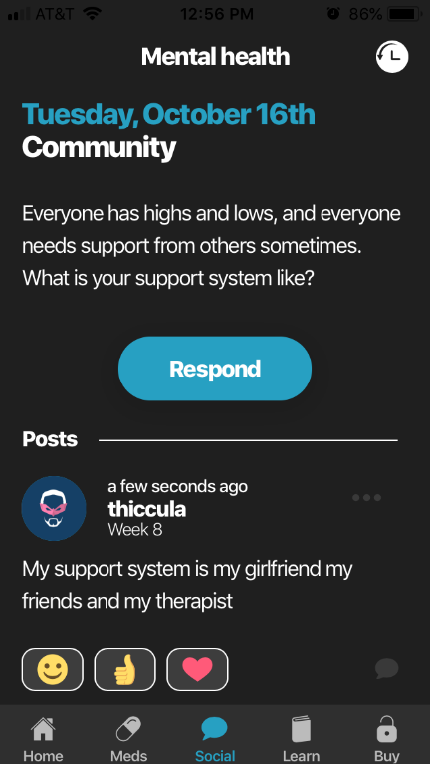
Prepared, Protected, emPowered
P3 is a theory-based (Social Cognitive Theory and Fogg behavioral model) comprehensive social networking PrEP adherence app for iOS and Android
Designed for young men who have sex with men (YMSM) and transwomen who have sex with men (YTW) who are on PrEP
Includes interactive components encouraging peer-to-peer sharing on a social wall and the development of medication self-monitoring behaviors through completion of daily quests and personalized medication tracking.
Game-based elements, including virtual and real-world rewards, based on behavioral economics principals, encourage engagement
Strengths-based adherence counseling delivered by a centrally-located adherence counselor via in-app messaging addresses individuals’ unique barriers to PrEP adherence.
Social Wall

Slide 7
Prepared, Protected, emPowered
P3 is a theory-based (Social Cognitive Theory and Fogg behavioral model) comprehensive social networking PrEP adherence app for iOS and Android
Designed for young men who have sex with men (YMSM) and transwomen who have sex with men (YTW) who are on PrEP
Includes interactive components encouraging peer-to-peer sharing on a social wall and the development of medication self-monitoring behaviors through completion of daily quests and personalized medication tracking.
Game-based elements, including virtual and real-world rewards, based on behavioral economics principals, encourage engagement
Strengths-based adherence counseling delivered by a centrally-located adherence counselor via in-app messaging addresses individuals’ unique barriers to PrEP adherence.
Medication tracker

Slide 8
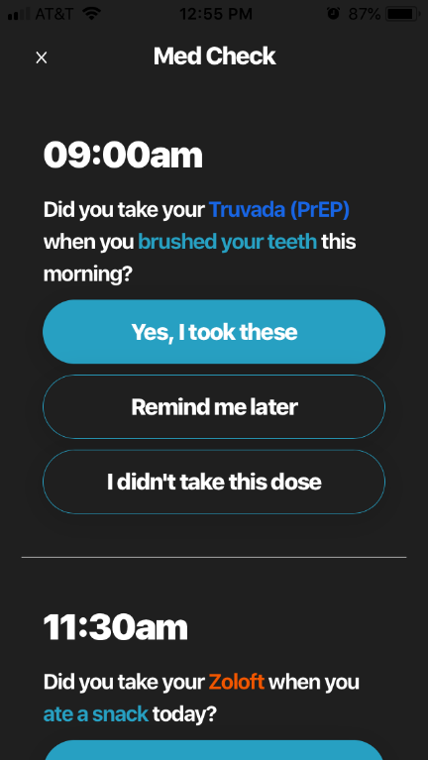
Prepared, Protected, emPowered
P3 is a theory-based (Social Cognitive Theory and Fogg behavioral model) comprehensive social networking PrEP adherence app for iOS and Android
Designed for young men who have sex with men (YMSM) and transwomen who have sex with men (YTW) who are on PrEP
Includes interactive components encouraging peer-to-peer sharing on a social wall and the development of medication self-monitoring behaviors through completion of daily quests and personalized medication tracking.
Game-based elements, including virtual and real-world rewards, based on behavioral economics principals, encourage engagement
Strengths-based adherence counseling delivered by a centrally-located adherence counselor via in-app messaging addresses individuals’ unique barriers to PrEP adherence.
Medication tracker

Slide 9
Prepared, Protected, emPowered
P3 is a theory-based (Social Cognitive Theory and Fogg behavioral model) comprehensive social networking PrEP adherence app for iOS and Android
Designed for young men who have sex with men (YMSM) and transwomen who have sex with men (YTW) who are on PrEP
Includes interactive components encouraging peer-to-peer sharing on a social wall and the development of medication self-monitoring behaviors through completion of daily quests and personalized medication tracking.
Game-based elements, including virtual and real-world rewards, based on behavioral economics principals, encourage engagement
Strengths-based adherence counseling delivered by a centrally-located adherence counselor via in-app messaging addresses individuals’ unique barriers to PrEP adherence.
Daily Quest

Slide 10
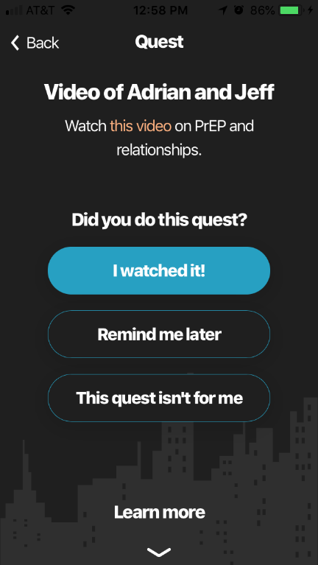
Prepared, Protected, emPowered
P3 is a theory-based (Social Cognitive Theory and Fogg behavioral model) comprehensive social networking PrEP adherence app for iOS and Android
Designed for young men who have sex with men (YMSM) and transwomen who have sex with men (YTW) who are on PrEP
Includes interactive components encouraging peer-to-peer sharing on a social wall and the development of medication self-monitoring behaviors through completion of daily quests and personalized medication tracking.
Game-based elements, including virtual and real-world rewards, based on behavioral economics principals, encourage engagement
Strengths-based adherence counseling delivered by a centrally-located adherence counselor via in-app messaging addresses individuals’ unique barriers to PrEP adherence.
Daily Quest

Slide 11
Prepared, Protected, emPowered
Earn real money and in-app points for use
P3 is a theory-based (Social Cognitive Theory and Fogg behavioral model) comprehensive social networking PrEP adherence app for iOS and Android
Designed for young men who have sex with men (YMSM) and transwomen who have sex with men (YTW) who are on PrEP
Includes interactive components encouraging peer-to-peer sharing on a social wall and the development of medication self-monitoring behaviors through completion of daily quests and personalized medication tracking.
Game-based elements, including virtual and real-world rewards, based on behavioral economics principals, encourage engagement
Strengths-based adherence counseling delivered by a centrally-located adherence counselor via in-app messaging addresses individuals’ unique barriers to PrEP adherence.
Use points to access an exclusive web series and choose-your-own-adventure style games

Slide 12
Prepared, Protected, emPowered
Earn real money and in-app points for use
P3 is a theory-based (Social Cognitive Theory and Fogg behavioral model) comprehensive social networking PrEP adherence app for iOS and Android
Designed for young men who have sex with men (YMSM) and transwomen who have sex with men (YTW) who are on PrEP
Includes interactive components encouraging peer-to-peer sharing on a social wall and the development of medication self-monitoring behaviors through completion of daily quests and personalized medication tracking.
Game-based elements, including virtual and real-world rewards, based on behavioral economics principals, encourage engagement
Strengths-based adherence counseling delivered by a centrally-located adherence counselor via in-app messaging addresses individuals’ unique barriers to PrEP adherence.
Use points to access an exclusive web series and choose-your-own-adventure style games

Slide 13
Prepared, Protected, emPowered
P3 is a theory-based (Social Cognitive Theory and Fogg behavioral model) comprehensive social networking PrEP adherence app for iOS and Android
Designed for young men who have sex with men (YMSM) and transwomen who have sex with men (YTW) who are on PrEP
Includes interactive components encouraging peer-to-peer sharing on a social wall and the development of medication self-monitoring behaviors through completion of daily quests and personalized medication tracking.
Game-based elements, including virtual and real-world rewards, based on behavioral economics principals, encourage engagement
Strengths-based adherence counseling delivered by a centrally-located adherence counselor via in-app messaging addresses individuals’ unique barriers to PrEP adherence.
Adherence Counselor

Slide 14
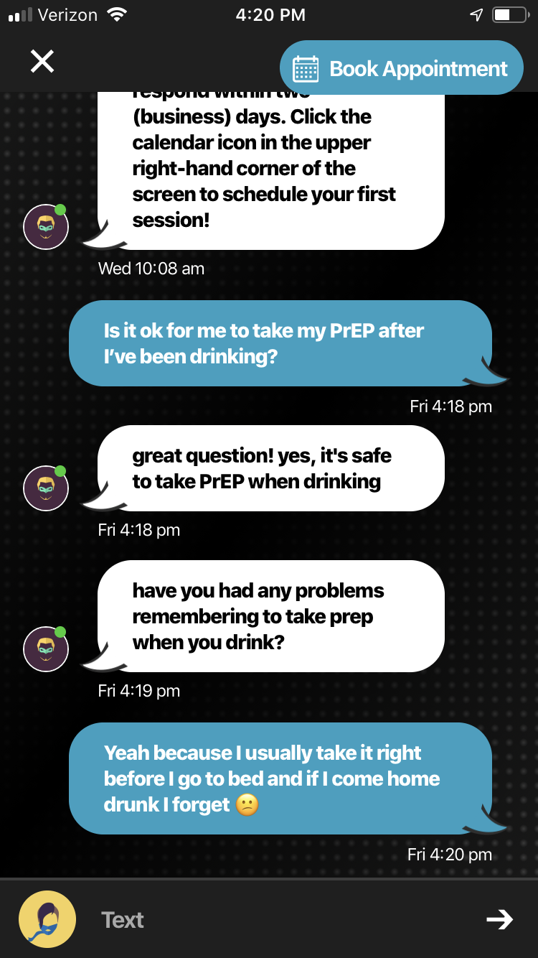
Prepared, Protected, emPowered
P3 is a theory-based (Social Cognitive Theory and Fogg behavioral model) comprehensive social networking PrEP adherence app for iOS and Android
Designed for young men who have sex with men (YMSM) and transwomen who have sex with men (YTW) who are on PrEP
Includes interactive components encouraging peer-to-peer sharing on a social wall and the development of medication self-monitoring behaviors through completion of daily quests and personalized medication tracking.
Game-based elements, including virtual and real-world rewards, based on behavioral economics principals, encourage engagement
Strengths-based adherence counseling delivered by a centrally-located adherence counselor via in-app messaging addresses individuals’ unique barriers to PrEP adherence.
Adherence Counselor

Slide 15
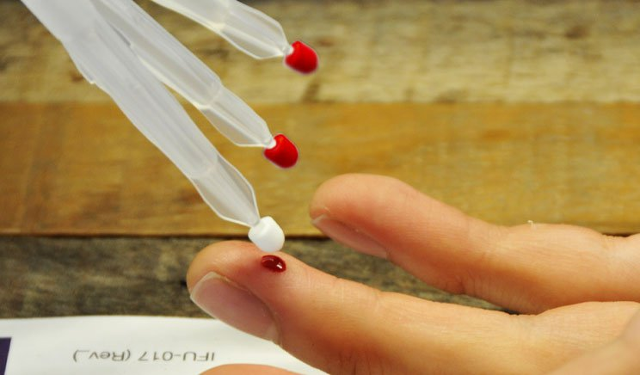
Methods
Aims of field testing were to assess technical feasibility of the app, back end data collection, and blood sample collection process.
Eligible participants were:
Men who have sex with men (MSM) or transgender women who had sex with men (TWSM)
Between 16-24 years old
HIV negative (self-report)
Owned a smart phone with a data plan
Had either recently initiated PrEP (started in the last 30 days) OR were PrEP non-adherent (self-report taking less than 6 pills a week)
Were living in one of three US cities (Houston, TX; Philadelphia, PA; Bronx, NY)
Participation was 30 days, with visits at baseline and 1 month follow-up, participants completed a computer-assisted survey and blood samples were collected for PrEP adherence measurement (i.e. TFVdp/FTCtp concentrations) via dried blood spot and mitra microsamplers at both visits.

Slide 16
Results
Demographics (n=16)
Demographics | (n) %
Mean age | 21.3
Race Black White Other | (4) 29.6 (8) 57.1 (2) 14.3
Hispanic or Latino | (11) 68.8
Identify as male | (16) 100
Identify as gay | (15) 93.8
Prior PrEP usage and discontinuation | (8) 50
STI past 3 months | (6) 37.5
Condomless anal sex with an HIV+ or unknown status partner in the prior 3 months | (7) 43.8
Length of time on PrEP >3 months 1-3 months <1 month | (4) 25 (8) 50 (4) 25
App was found to be feasible and acceptable
Identified and fixed bugs within the app
Both study staff and participants preferred mitra microsampling collection to DBS. Mitra will be used in the full RCT.

Slide 17
Results
Changes in PrEP Self Efficacy from BL to FU (n=15)
Self Efficacy Measure | P value
Follow a plan for taking PrEP | 0.0385*
Keep your PrEP medical appointments | 0.3776
Take PrEP at work | 0.0750
Take PrEP on a weekend | 0.0067*
Take PrEP at social outing | 0.0173*
Take PrEP at a party | 0.0417*
Take Prep when having Medication Side Effects | 0.0282*
Take PrEP at a planned event | 0.1094
Take PrEP at an unplanned event | 0.5845
Take PrEP while traveling | 0.2254
Self-reported adherence (i.e. mean percent of time taken PrEP in the past month) improved from 72.5% to 89.3% between visits (p=0.010)
Median TFVdp and FTCtp increased by 44% and 62%, respectively between visits, although the increase was not statistically significant (p>0.1)
All measures of PrEP self-efficacy improved, with significance detected in ability to follow a PrEP plan, take PrEP on a weekend, at a social outing or party, and take PrEP when having medication side effects.

Slide 18
P3 RCT Launched: May, 2019
Evaluating the efficacy of P3 in 8 cities in the US: Atlanta, GA; Boston, MA; Bronx, NY; Chapel Hill, NC; Chicago, IL; Houston, TX; Philadelphia, PA; Tampa, FL
Primary outcome: Changes in PrEP adherence from Baseline to Month 6. PrEP adherence is measured by blood sample levels of tenofovir diphosphate and emtricitabine triphosphate (TFV-DP/FTC-TP) blood plasma concentration consistent with > 4 doses/week at 3- and 6- month follow-ups.
PrEP criteria for enrollment:
Are not currently on PrEP but plan to initiate in the next 7 days and have an active PrEP prescription (prescription confirmed by study staff)
OR initiated PrEP within the last 30 days (<30 days) and have an active PrEP prescription
OR on PrEP >30 days but self-report adherence on average <6 pills per week over the past month and have an active PrEP prescription
Currently 24 enrolled in 3 arm RCT (planning to enroll 240 total)

Slide 19
Find out more about
At IAS:
Poster WEPDC0106
Poster WEPED867
Online at:
https://itechnetwork.org/protocols/p3/
http://batlab.web.unc.edu/p3/
https://clinicaltrials.gov/ct2/show/NCT03320512?term=p3&rank=1 or search “P3”

Slide 20
Mitra Data

